Slide 1








Academic and Professional Exchange
Opportunities in the U.S.
Nnamdi Azikiwe University
Awka, Anambra State
Friday, June 22, 2018
Presentation By
Clemson Ayegbusi
Public Affairs Section, U.S. Mission Nigeria
http://nigeria.usembassy.gov/

Slide 2
OBJECTIVES
Discuss the purpose of the Fulbright program
Discuss the Fulbright research, teaching and mentorship opportunities in the U.S.
Discuss other academic and professional exchange opportunities in the U.S.
Public Affairs Section, U.S. Mission Nigeria
http://nigeria.usembassy.gov/

Slide 3

The Fulbright Program and its Purpose
The Fulbright program is America’s flagship international educational exchange program designed to promote mutual understanding between the people of the United States and the people of other countries of the world including Nigeria.
Public Affairs Section, U.S. Mission Nigeria
http://nigeria.usembassy.gov/

Slide 4
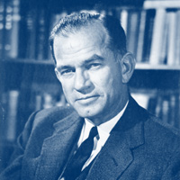
The Fulbright Program: A History
Established by U.S. Congress in 1946 under legislation introduced by Senator J. William Fulbright of Arkansas.
Sends U.S. students, scholars, artists and professionals to other countries. It also sends students, scholars, artists and professionals from abroad to the United States
Sponsored by the U.S. Department of State’s Bureau of Educational and Cultural Affairs
Administered by the U.S. embassy and the U.S. Consulate General in Lagos, Nigeria
Over 8,000 Fulbright grants are awarded annually. Approximately 330,000 “Fulbrighters” to date.
Senator J. William Fulbright
“International education exchange is the most significant current project designed to continue the process of humanizing mankind to the point, we would hope, that nations can learn to live in peace.”
Public Affairs Section, U.S. Mission Nigeria
http://nigeria.usembassy.gov/

Slide 5


The Prestigious Fulbright Program
Fulbright is the most widely recognized and prestigious international exchange program in the world.
Over 156 countries worldwide, including Nigeria participate in this program
Public Affairs Section, U.S. Mission Nigeria
http://nigeria.usembassy.gov/

Slide 6
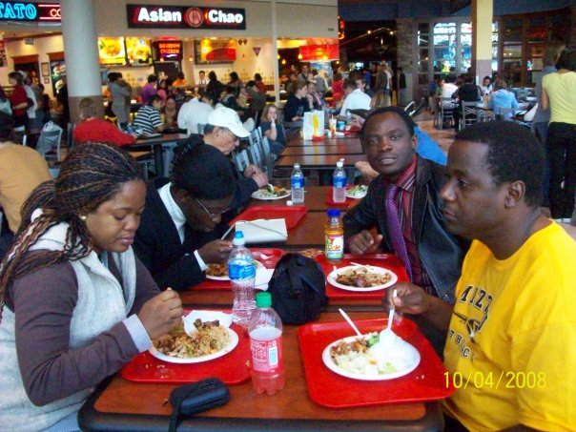
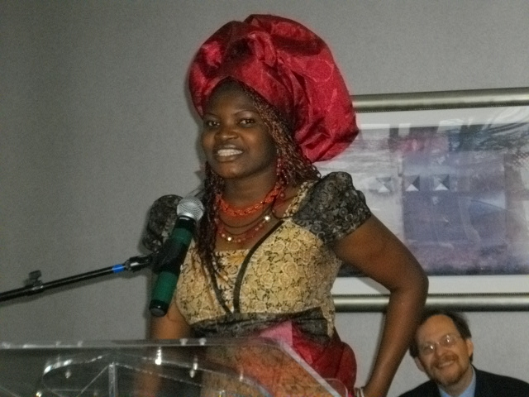
Goals of the Fulbright Program
Cultural exchange
Academic development
Professional development
Personal development
Promotion of collaborative research to solve global problems
Foster international cooperation and networking
Public Affairs Section, U.S. Mission Nigeria
http://nigeria.usembassy.gov/

Slide 7

Fulbright Grant Categories
The term “Fulbright Program” encompasses a variety of exchange programs, including both individual and institutional grants.
Now lets talk about the Fulbright grant categories.
Public Affairs Section, U.S. Mission Nigeria
http://nigeria.usembassy.gov/

Slide 8
Fulbright Foreign Student Program
Formerly referred to as the Fulbright Junior Staff Development Program
This program is designed for doctoral students.
It offers them the opportunity to conduct doctoral research at U.S. academic or research institutions for one academic year.
Call for Applications: February 1
Deadline for submitting online application and all supplementary documents: June 1
Grant Benefits: J-1 visa, round trip airfare to the U.S., a settling-in allowance, monthly stipend, housing allowance, books-and-supplies allowance, and computer allowance. The grant also covers health insurance.
Online application and instructions can be found at https://iie.embark.com/auth/login
Public Affairs Section, U.S. Mission Nigeria
http://nigeria.usembassy.gov/

Slide 9
Fulbright African Research Scholar Program (ARSP)
This program is designed for senior scholars or university faculty or administrators with less experience.
The program offers two types of grants:
Research Grants
Awards of 3 to 9 months are offered to senior faculty with at least 3 years of post doctoral experience to conduct research in any academic discipline at a U.S. academic or research institution.
2) Program and Curriculum Development Grants
Awards of 3 to 9 months are offered to senior scholars or administrators with less experience. A doctorate degree is not required under this grant category, but applicants must hold a minimum of a master’s or equivalent graduate degree. Proposals should be linked to professional duties and demonstrate how the scholar will use the knowledge gained to develop new courses, curricula, or other academic programs at the home institution.
Public Affairs Section, U.S. Mission Nigeria
http://nigeria.usembassy.gov/

Slide 10
Fulbright African Research Scholar Program (ARSP)
Call for Applications: February 1
Deadline for submitting online application and all supplementary documents: June 1
Grant Benefits: J-1 visa, round trip airfare to the U.S., a settling-in allowance, professional allowance, monthly stipend, housing allowance, books-and-supplies allowance, and computer allowance. The grant also covers health insurance.
Grant covers travel of one dependent if he/she will stay with the grantee for at least 80% of the grant period. It also covers dependent allowance.
Online application and instructions can be found at https://iie.embark.com/apply/visitingscholars
Public Affairs Section, U.S. Mission Nigeria
http://nigeria.usembassy.gov/

Slide 11
Fulbright Foreign Language
Teaching Assistant Program (FLTA)
This is a non-degree program designed for graduate students or faculty who are teachers. It offers them an opportunity to teach Yoruba or Hausa language and culture to American students in U.S. universities and colleges.
The program also gives an opportunity for participants to refine their teaching skills, increase their English language proficiency and broaden their knowledge of American culture and customs by engaging in non-degree studies.
Call for Applications: February 1
Deadline for submitting online application and all supplementary documents: June 1
Public Affairs Section, U.S. Mission Nigeria
http://nigeria.usembassy.gov/

Slide 12
Fulbright Foreign Language
Teaching Assistant Program (FLTA)
Grant Benefits: J-1 visa, round trip airfare to the U.S., a settling-in allowance, monthly stipend, housing allowance, health insurance, and tuition scholarship, participation in summer orientation, Fulbright enrichment seminar and conferences.
Online application and instructions can be found at https://iie.embark.com/apply/flta
Program information: http://foreign.fulbrightonline.org/about/fulbright-flta
Public Affairs Section, U.S. Mission Nigeria
http://nigeria.usembassy.gov/

Slide 13
Fulbright Scholar-in-Residence Program (SIR)
This is a Fulbright grants to scholars to teach or lecture in U.S. colleges and universities for a semester or academic year.
SIR grantees also assist in developing curricula and serve as a resource for faculty, students, and the community.
Application Process: U.S. colleges and universities apply for scholar from another country to teach at their institution OR U.S. Embassy or Consulate recruit scholars for American universities.
The institution can name a particular scholar or request recruitment of a scholar with specified criteria.
For more information: http://www.cies.org/
Public Affairs Section, U.S. Mission Nigeria
http://nigeria.usembassy.gov/

Slide 14
Fulbright Specialist Program (FSP)
The Fulbright Specialist program sends U.S. scholars, professionals to universities, cultural and research institutions in Nigeria for 2 – 6 weeks.
Nigerian universities, cultural and research institutions could host a Fulbright Specialist who can serve in any academic capacity needed. Fulbright Specialists can help Nigerian institution build capacity, train and mentor teaching and non-teaching staff, conduct seminars and workshops and so on.
Application Process: In order to host a specialist, interested institution must complete a Fulbright Specialist Project Request application.
For more information, please send an email to AyegbusiCO@state.gov
Public Affairs Section, U.S. Mission Nigeria
http://nigeria.usembassy.gov/

Slide 15
Other Academic and Professional Exchange Opportunities funded by the U.S. Government
Very briefly, I am going to talk about the following programs:
Study of the U.S. Institutes for Scholars
Study of the U.S. Institutes for Student Leaders
Hubert H. Humphrey Fellowship Program
Public Affairs Section, U.S. Mission Nigeria
http://nigeria.usembassy.gov/

Slide 16
Study of the U.S. Institutes for Scholars
It is typically a six-week intensive post-graduate level academic programs with integrated study tours
This program provides scholars the opportunity to deepen their understanding of American society, culture, values, and institutions.
The ultimate goal of the program is to strengthen curricula and to improve the quality of teaching about the United States in academic institutions abroad.
Call for Nominations: November
Closing Date: January 15
Public Affairs Section, U.S. Mission Nigeria
http://nigeria.usembassy.gov/

Slide 17
Study of the U.S. Institutes for Scholars
A total of six summer institutes are offered for multinational groups of experienced university faculty, scholars, and other related professionals.
Institute on Foreign Policy
Institute on Religious Pluralism
Institute on Contemporary U.S. Literature
Institute on Journalism & Media
Institute on U.S. Politics & Political Thought
Institute on U.S. Culture & Society
Public Affairs Section, U.S. Mission Nigeria
http://nigeria.usembassy.gov/

Slide 18
Study of the U.S. Institutes for Student Leaders
An intensive short term academic programs whose purpose is to provide groups of undergraduate student leaders with a deeper understanding of the United States, while simultaneously enhancing their leadership skills.
It is a five-week institutes consisting of a balanced series of seminar discussions, readings, group presentations, and lectures.
It involves educational travel, site visits, leadership activities, and volunteer opportunities within the local community.
Call for Nominations: November
Closing Date: January 15
Public Affairs Section, U.S. Mission Nigeria
http://nigeria.usembassy.gov/

Slide 19
Study of the U.S. Institutes for Student Leaders
Candidate Description and Qualifications:
Be between 18 and 25 years of age.
Have a strong interest in social entrepreneurship.
Demonstrate strong leadership qualities and potential in their university and community activities.
Have a sustained high level of academic achievement, as indicated by grades, awards, and teacher recommendations.
Have demonstrated commitment to community and extracurricular university activities.
Be mature, responsible, independent, confident, open-minded, tolerant, thoughtful, and inquisitive.
Public Affairs Section, U.S. Mission Nigeria
http://nigeria.usembassy.gov/

Slide 20
The Hubert H. Humphrey Fellowship Program
This is a prestigious program that takes outstanding mid-career professionals to the United States for a year of professional development and non-degree academic work at the graduate level
The program also offers leadership development, and professional collaboration with U.S. counterparts.
Call for Nominations: April 1
Closing Date: June 1
Post Selection Committee Meeting: August
Public Affairs Section, U.S. Mission Nigeria
http://nigeria.usembassy.gov/

Slide 21
The Hubert H. Humphrey Fellowship Program
PROGRAM FIELDS:
Sustainable Development
Agricultural and Rural Development
    Economic Development
    Finance and Banking
    Natural Resources, Environmental Policy, and Climate Change
    Urban and Regional Planning
Democratic Institution Building
Communications/Journalism
    Law and Human Rights
    Public Policy Analysis and Public Administration
    Trafficking in Persons Policy and Prevention
    Technology Policy and Management
    Human Resource Management
Public Affairs Section, U.S. Mission Nigeria
http://nigeria.usembassy.gov/

Slide 22
The Hubert H. Humphrey Fellowship Program
PROGRAM FIELDS:
Education
Educational Administration, Planning and Policy
Higher Education Administration
Teaching of English as a Foreign Language
Public Health
Public Health Policy and Management
HIV/AIDS Policy and Prevention
Substance Abuse Education, Treatment and Prevention
Public Affairs Section, U.S. Mission Nigeria
http://nigeria.usembassy.gov/

Slide 23
The Hubert H. Humphrey Fellowship Program
You can visit the Hubert Humphrey Fellowship program website to learn more about the program at:
www.humphreyfellowship.org
The online application can be found at:
https://iie.embark.com/apply/humphreyfellowship2019
Public Affairs Section, U.S. Mission Nigeria
http://nigeria.usembassy.gov/

Slide 24


U.S. MISSION GOALS
Areas of study/research related to
U.S. Mission objectives are given preference
Democracy and Good governance
Education
Human rights
Girls and women empowerment
Economic prosperity and security
Regional stability
Counter-terrorism
Food security
Infectious Diseases and HIV/AIDS
Social and environmental issues
Public Affairs Section, U.S. Mission Nigeria
http://nigeria.usembassy.gov/

Slide 25

HOW DO I APPLY FOR USG FUNDED PROGRAM
Public Affairs Section, U.S. Mission Nigeria
http://nigeria.usembassy.gov/

Slide 26

APPLYING FOR THE FULBRIGHT PROGRAM
The competition for the Fulbright grants is merit-based.
Candidates are selected based on variety of factors, that may include (but not limited to) academic qualification, project feasibility, personal leadership ability, and available grant funds.
The Fulbright program’s application process is lengthy and rigorous.
Prospective applicants are encouraged to consider carefully their intentions, goals, future plans and prospective projects before applying for a grant.
Consult Fulbright alumni for guidance and advice.
Public Affairs Section, U.S. Mission Nigeria
http://nigeria.usembassy.gov/

Slide 27
FORMAT OF RESEARCH & PROJECT PROPOSAL
Background of the research
Research objectives
Significance of the research
Methodology
Justification for conducting the research/project in the U.S.
Feasibility of conducting the research within the time frame
Planned activities and anticipated outcomes
Evaluation and dissemination of the findings
English Proficiency
Public Affairs Section, U.S. Mission Nigeria
http://nigeria.usembassy.gov/

Slide 28

For More Information
Visit: ng.usembassy.gov
Contact the Fulbright Coordinator at:
NigeriaFulbright@state.gov and AyegbusiCO@state.gov
February 1
Deadline for submitting online application and all supplementary documents is June 1
Public Affairs Section, U.S. Mission Nigeria
http://nigeria.usembassy.gov/

Slide 29
QUESTIONS?
Public Affairs Section, U.S. Mission Nigeria
http://nigeria.usembassy.gov/

Slide 30
APPRECIATION
Thank you
for your Attention
Public Affairs Section, U.S. Mission Nigeria
http://nigeria.usembassy.gov/

